Slide 1


Slide 2
oneM2M use cases, interworking, Testing and Certifications
oneM2M Testing Framework and Certification
By
Laurent Velez
ETSI

Slide 3
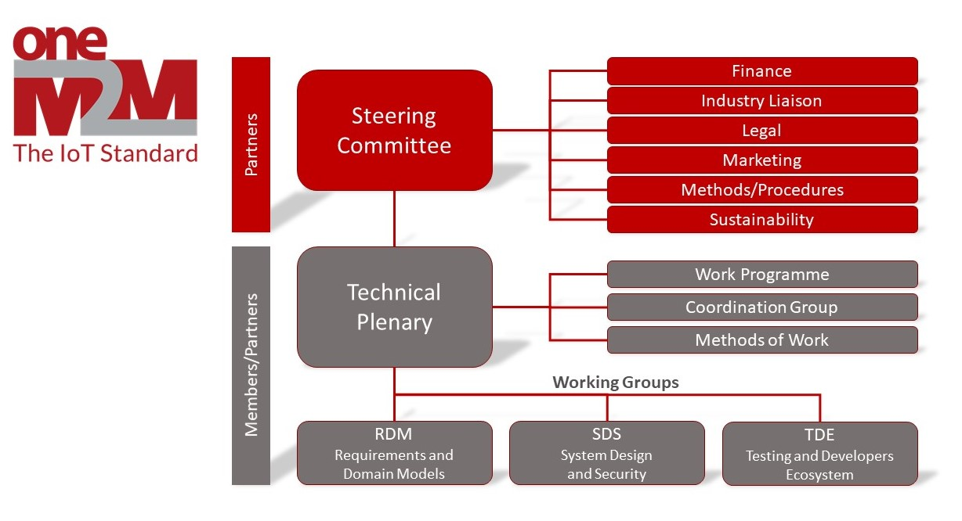
oneM2M Organization
https://onem2m.org/harmonization-m2m/organisation

Slide 4
Validation and Testing
  These 2 steps come together with the standard specification: it is about making sure that the standards do the right thing (Validation/Interop) and that they do it right (Conformance Testing)
  oneM2M WG TDE aims at having set of standardized test specifications associated with the main base standards.
  Usually Conformance or Interoperability tests are
    For use by industry development processes
    For 3rd party certification
    Scope , development and the review done by the oneM2M WG TDE

Slide 5
Conformance testing
Black-Box testing : Stimulation and Response
Conformance testing concentrates on specific components in a system
Conformance testing is applied over open interfaces and checks for conformance to the requirements in a base specification.
Unit testing
Reqs.

Slide 6
Interoperability testing
Tests (end-to-end) functionality between 2 or more products
It shows, from the user's viewpoint, that functionality is accomplished (but not how).
System testing
system testing

Slide 7
Interop and Conformance are Complementary
  Products could happen to be Interoperable but not conformant
  Products could happen to be conformant but not interoperable
  Interop testing is more appropriate when the standard is in development phase . It helps to validate the standards
  Conformance testing is more appropriate for testing stable specifications and is for testing product and check if the standard is correctly implemented

Slide 8
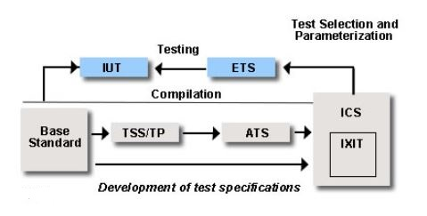
Development of Conformance Test Specifications
ATS : Abstract Test Suite
TP : Test Purposes
TSS : Test Suite Structure
IXIT : Implementation eXtra Information for Testing
ETS : Executable Test Suite
ICS : Implementation Conformance Statement
IUT : Implementation Under Test

Slide 9
What is TTCN-3?
www.ttcn-3.org
Testing and Test Control Notation Version 3
Internationally standardized language developed specifically for executable test specification
  Specified by ETSI MTS Technical Committee
  Is independent of a specific IUT or IUT interfaces
  Is independent of a test execution environment
  Standard available at portal.etsi.org via ETSI programme
Allows unambiguous implementation of tests
Look and feel of a regular programming language
Good tool support (many commercial tools available)
Successfully deployed in different organizations and industry in a variety of application domains
  e.g., telecom, automotive, software, etc.

Slide 10
WG TDE main specifications
Methodology:
  TS-0015 : Testing Framework
Interoperability Testing
  TS-0013: Interop Testing
Conformance Testing
  Conformance on oneM2M primitives: PICS TS-0017, TSS&TP TS-0018 and ATS TS-0019
  Definition of product profiles : TS-0025
Developer Guides : Series of 8 Technical Reports ➔ more to come soon
API Guide : TR-0051

Slide 11
Why Validate Standards?
Validation reveals problems/errors in
  Standards and Products
Validated standards give a higher chance of interoperable products
  - For standardisers gives assurance that they provide right functionality
  - For manufacturers and operators gives confidence to implement and go to market
Provides an opportunity to correct errors in a controlled manner
  Late fixes in the product cycle are more expensive than early ones
  Decreases time to market
Standards can be validated by several means but one of the most practical and cost effective is by interop events

Slide 12
oneM2M Interop Events
Co-organized and funded by TTA and ETSI
Past events
  Sept 2015 Sophia-Antipolis
  May 2016 Seoul
  Dec 2016 Kobe
  May 2017 Taipei
  July 2018 Washington DC
  Nov 2020 Virtual
Free of charge
Open to all companies with oneM2M implementations (members and non-members)
Covered by NDA. No companies results are published
Important technical feedback provided to oneM2M

Slide 13
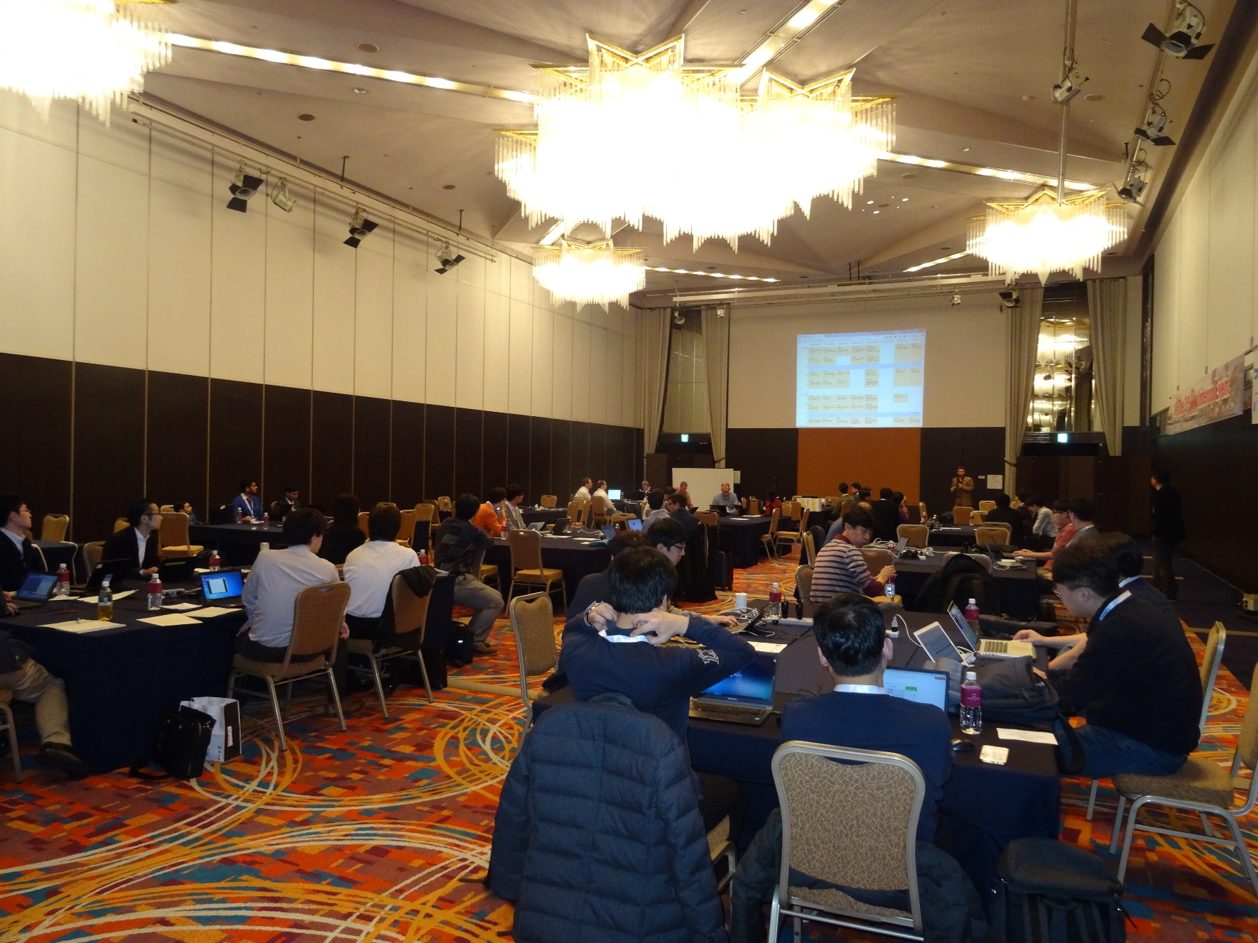
Interop#3 Kobe (2016)

Slide 14
Certification
Program

Slide 15

oneM2M Certification Background
oneM2M - oneM2M CB
oneM2M
oneM2M
Certification Body (CB)
SC
TP
Authorized Test Lab(ATL)
TDE

Slide 16
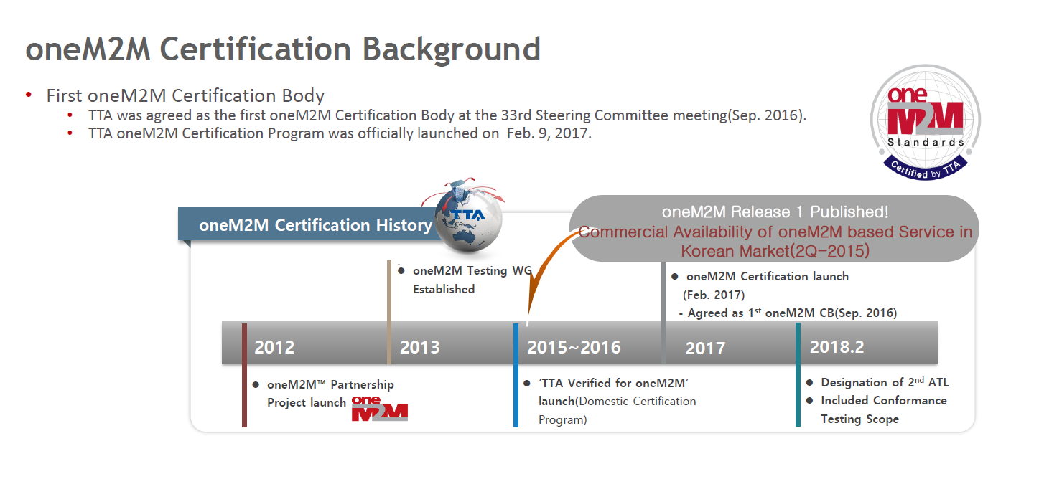
TTA Certification

Slide 17

Global certification solution for oneM2M
oneM2M Certification is intended to create an ecosystem of certified products that ensures interoperability among oneM2M certified products
https://www.globalcertificationforum.org/
https://onem2m.globalcertificationforum.org/

Slide 18
oneM2M Certification by GCF
GCF launched oneM2M Release 1 certification programme in July 2019
Release 2 certification Development is underway targeted for Mid 2021.
Release 3 Work Item are now underway at the Internet of Things Agreement Group (IAG)
Program is open to both GCF members and non-members
A product can be oneM2M certified as part of its normal GCF device certification. Alternatively, products can ne oneM2M certified as a ‘standalone’ certification.
Source: GCF

Slide 19
Testing in oneM2M standard
Interoperability
(TS-0013)
Relation between oneM2M Specifications
ICS
(TS-0017)
Functional Architecture
(TS-0001)
which feature to be implemented?
Certification
Test Purposes
(TS-0018)
which feature needs to be tested?
Abstract Test Suite (TS-0019)
Core Protocol
(TS-0004)
summarized
prepare test cases for products
Features Catalogue
(TS-0031)
Product Profiles (TS-0025)
referred
glimpse of oneM2M
guideline for product
planning

Slide 20
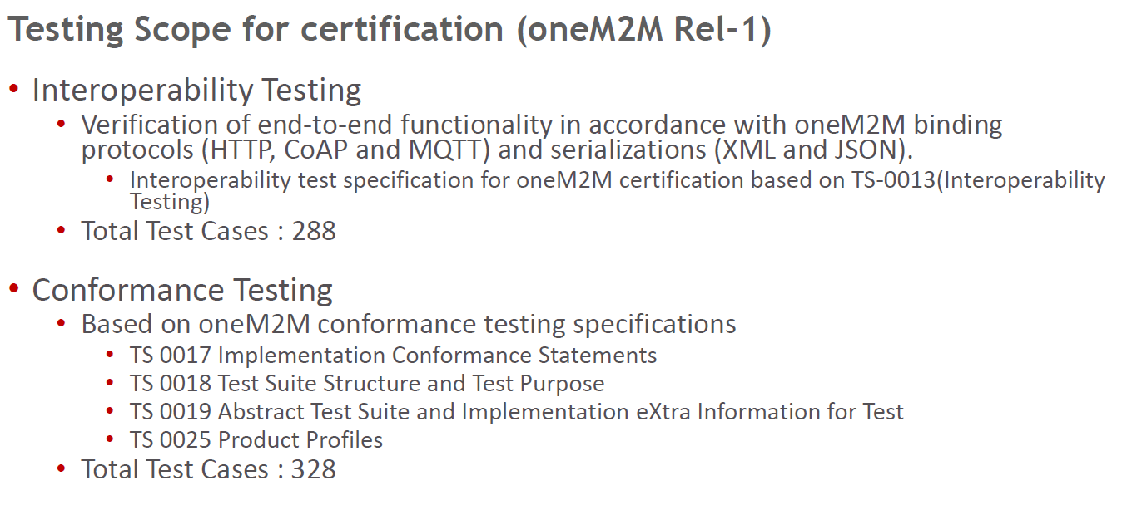
oneM2M Certification program
Source: TTA
Notes:
I will not enter in details but I put for information some details of the release 1 certification program

Slide 21
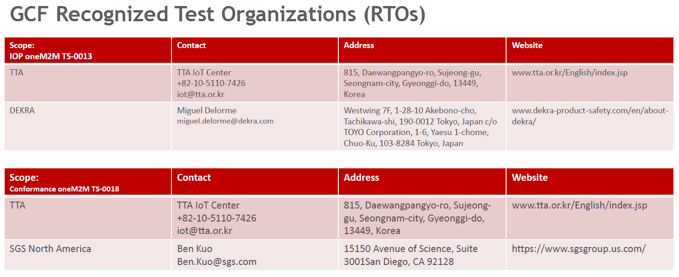
oneM2M Certification program
Source: TTA

Slide 22
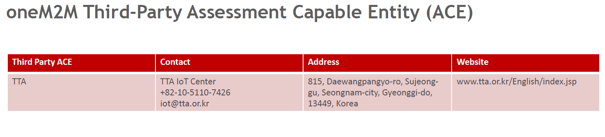
oneM2M Certification program
Source: TTA

Slide 23
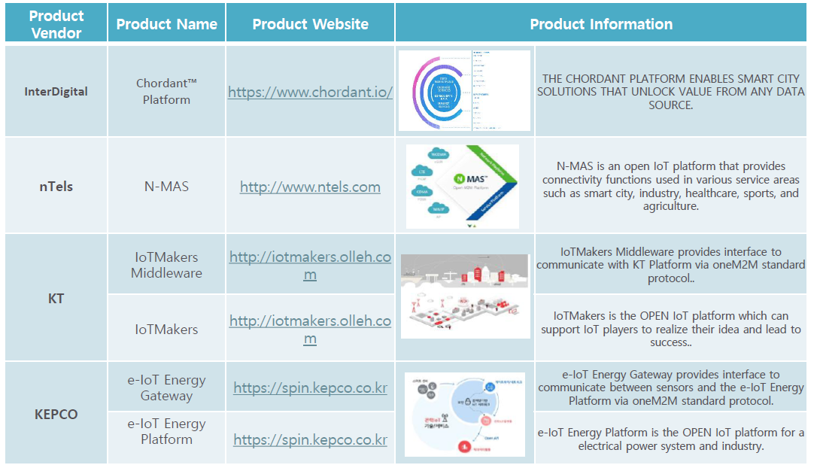
oneM2M Certification program
33 Certified products
from more than 20 manufacturers
https://onem2m.globalcertificationforum.org/all-certifications.html
Source: GCF

Slide 24
Contact names
oneM2M WG TDE
Chair : Andrew Min-gyu Han (Hansung University) : andyhan@hansung.ac.kr
Vice-chair : Bob Flynn (Exacta) : bob.flynn@exactagss.com
Conformance Testing:
Miguel Angel Reina Ortega (ETSI) : MiguelAngel.ReinaOrtega@etsi.org
oneM2M Certification:
Asif Hamidullah (GCF) : asif.hamidullah@globalcertificationforum.org
Keebum Kim (TTA and Relation GCF-oneM2M) : keebum.kim@tta.or.kr

Slide 25
Developer corner

Slide 26
Developer Guides
https://www.onem2m.org/developer-guides
TR-0025 | Application developer guide: Light control example using HTTP binding
TR-0034 | Developer Guide: CoAP binding and long polling for temperature monitoring
TR-0038 | Developer guide: Implementing security example
TR-0045 | Developer guide: Implementing Semantics
TR-0039 | Developer guide: Interworking Proxy using SDT
TR-0035 | Developer guide: Device Management use case
TR-0037 | Developer guide: smart farm example using MQTT binding
TR-0047 | Developer guide: 3GPP interworking example

Slide 27
Developer resources
Hackster.io
https://www.hackster.io/onem2m
oneM2M repository
https://git.onem2m.org
oneM2M on Github
https://github.com/oneM2M-Tutorials
https://github.com/oneM2M/ (soon)
Stack overflow
https://stackoverflow.com/questions/tagged/onem2m
Open Source implementations:
https://www.onem2m.org/using-onem2m/developers/device-developers#n4a

Slide 28
Teaching materials
oneM2M Advanced Training
https://www.youtube.com/playlist?list=PLDd4EJmw5gUlIXL0oek7RicHC5iFGfh1Z
Hyderabad university tutorial
  https://mooc.indiaeu-ictstandards.in/courses/onem2m/
IoT/oneM2M Semantic tutorial part 1
  https://www.youtube.com/playlist?list=PLDd4EJmw5gUmpyvOvcjoaVeSzM8Q4PvKB

Slide 29
Developer events
Developer Tutorials :
  IEEE Globecom conference, Polytech university, ETSI IoT week, etc…
Hackathons:
  Dallas (US), Toulouse and Toulon (FR), Wollongong (AUS) , Campinas (BR), Seoul (KR), Malaga (ES)
  More than 10 hackathons/developer events in India.

Slide 30
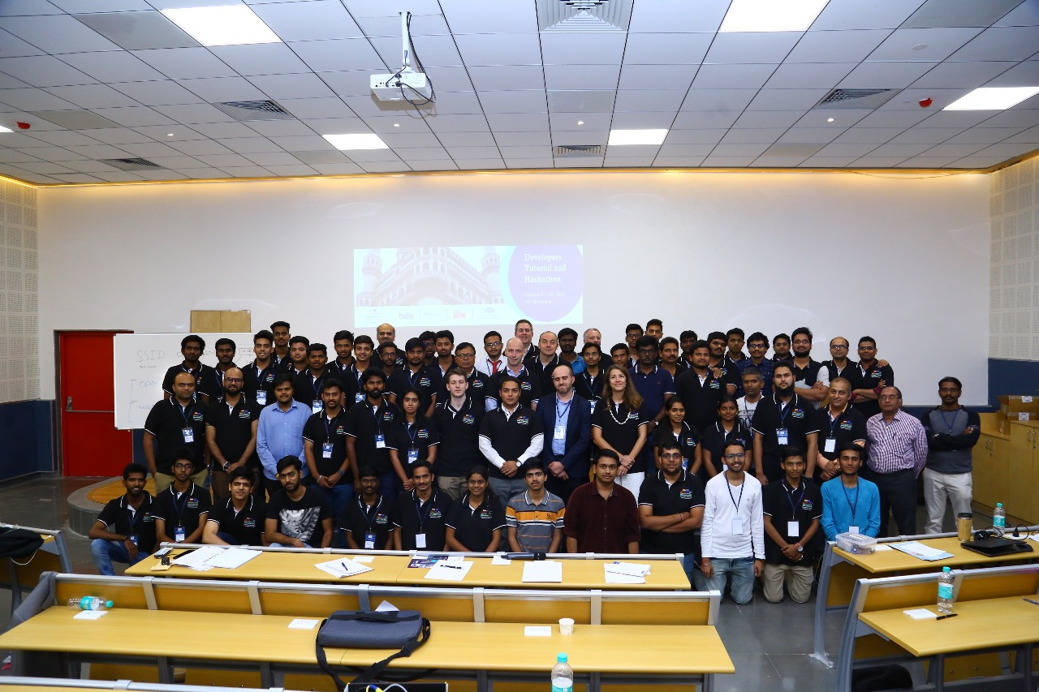

Slide 31
Thank You
Laurent.Velez@etsi.org
Notes:
31

